Slide 1
CUSTOMER PREDICTION
2022-11-22

Slide 2
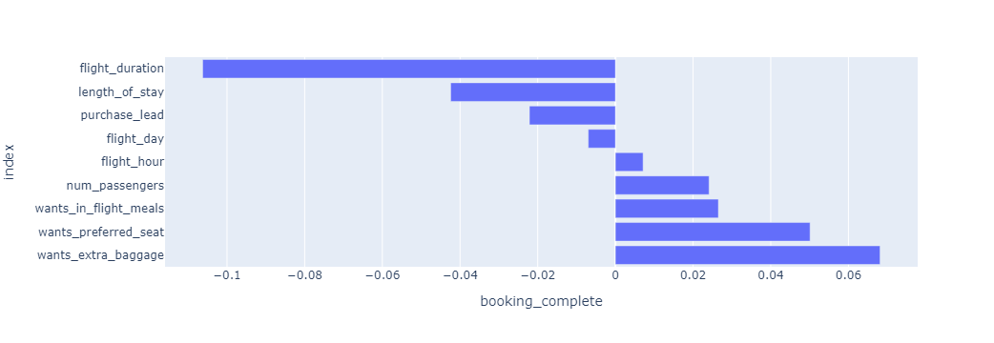
RESULTS
Evaluation
According to data exploration, no attributes has strong relationship between the final purchase behavior.
After processing categorical variables and construct a neural network classifier, we are manage to obtain a final model contain a train score 0.85025 and test score 0.85190.
Still, there are some room to improve the prediction model, we suggest to add more external resource to provide a better prediction metric for further business purpose.

